Slide 1
Fall 2020 Industry Outlook Survey
Tuesday, September 22, 2020

Slide 2
103
Total Responses
Date Created: Monday, September 07, 2020
Complete Responses: 103

Slide 3
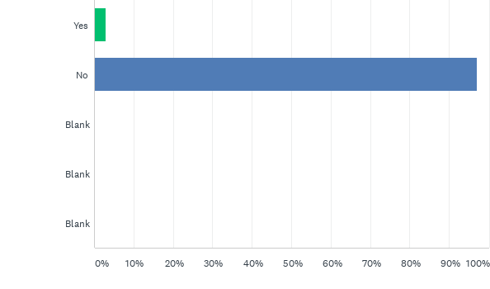
Q1: Do you have any hotels that are meeting or exceeding 2020 budgeted RevPAR?
Answered: 103 Skipped: 0

Slide 4
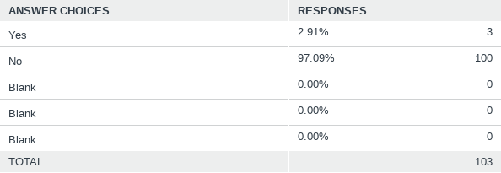
Q1: Do you have any hotels that are meeting or exceeding 2020 budgeted RevPAR?
Answered: 103 Skipped: 0

Slide 5
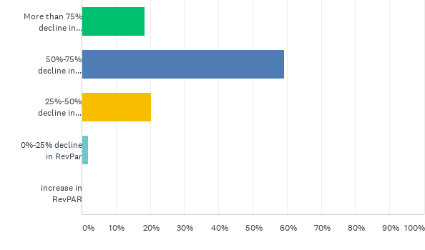
Q2: What is your 2020 full year forecast for RevPAR versus budget for your entire portfolio?
Answered: 103 Skipped: 0

Slide 6
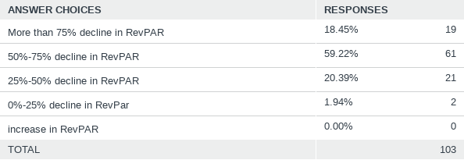
Q2: What is your 2020 full year forecast for RevPAR versus budget for your entire portfolio?
Answered: 103 Skipped: 0

Slide 7
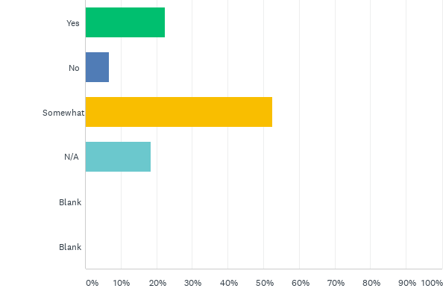
Q3: If you have brand managed properties, did you find them to be effective partners in addressing the impact of Covid?
Answered: 103 Skipped: 0

Slide 8
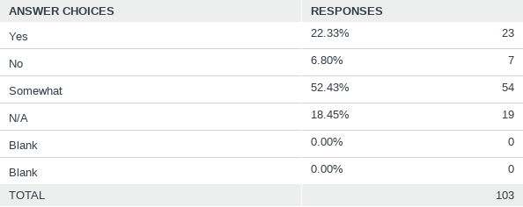
Q3: If you have brand managed properties, did you find them to be effective partners in addressing the impact of Covid?
Answered: 103 Skipped: 0

Slide 9
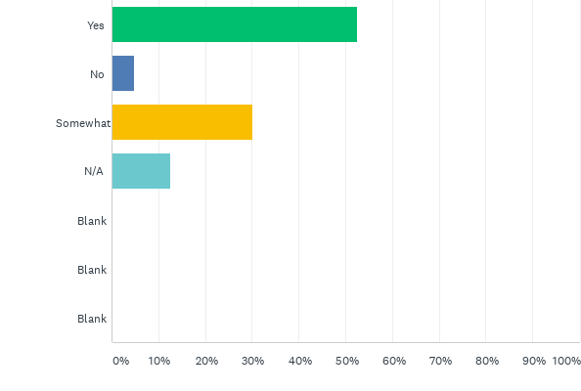
Q4: For your properties managed by third party management companies, did you find them to be effective partners in addressing the impact of Covid?
Answered: 103 Skipped: 0

Slide 10
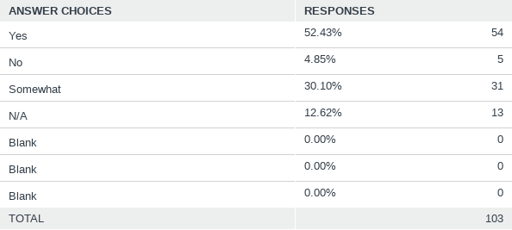
Q4: For your properties managed by third party management companies, did you find them to be effective partners in addressing the impact of Covid?
Answered: 103 Skipped: 0

Slide 11
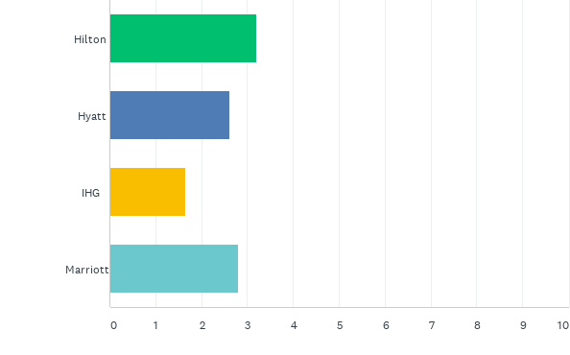
Q5: Please Rank the Major Brands that you think have most effectively addressed Covid as an Owner.
Answered: 87 Skipped: 16

Slide 12
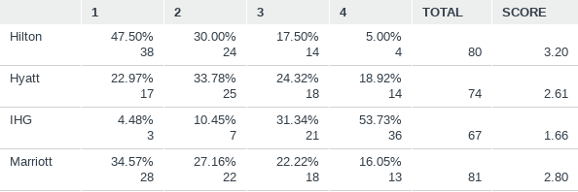
Q5: Please Rank the Major Brands that you think have most effectively addressed Covid as an Owner.
Answered: 87 Skipped: 16

Slide 13
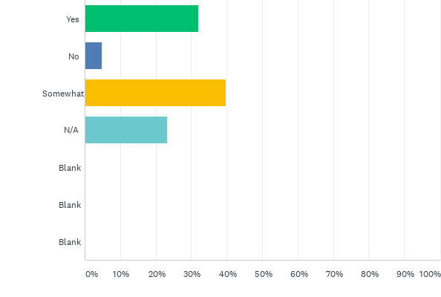
Q6: For your properties with non-CMBS debt, are you finding your lenders to be flexible partners?
Answered: 103 Skipped: 0

Slide 14
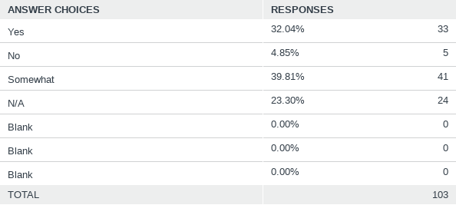
Q6: For your properties with non-CMBS debt, are you finding your lenders to be flexible partners?
Answered: 103 Skipped: 0

Slide 15
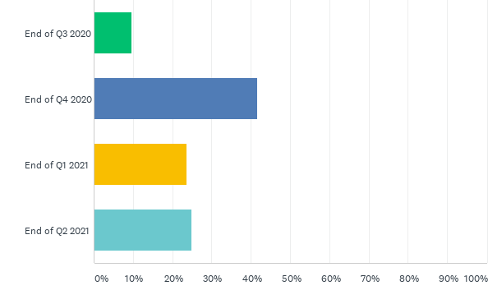
Q7: If you answered yes above, when do you expect lenders to stop being flexible?
Answered: 72 Skipped: 31

Slide 16
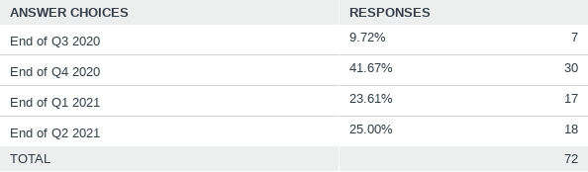
Q7: If you answered yes above, when do you expect lenders to stop being flexible?
Answered: 72 Skipped: 31

Slide 17
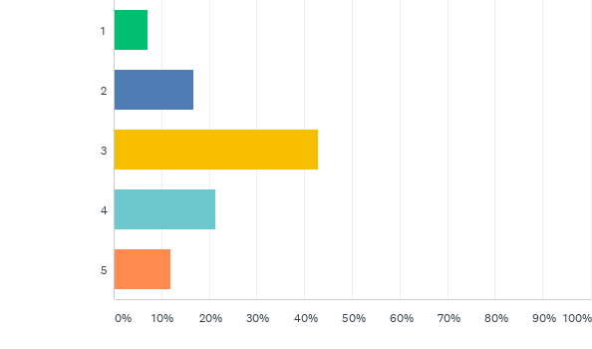
Q8: If you answered no to question number 6 above, how much trouble are you in on a scale of 1 to 5 with 1 being "not much" and 5 being "doomed."
Answered: 42 Skipped: 61

Slide 18
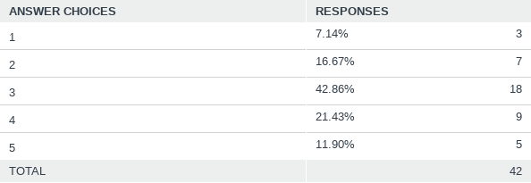
Q8: If you answered no to question number 6 above, how much trouble are you in on a scale of 1 to 5 with 1 being "not much" and 5 being "doomed."
Answered: 42 Skipped: 61

Slide 19
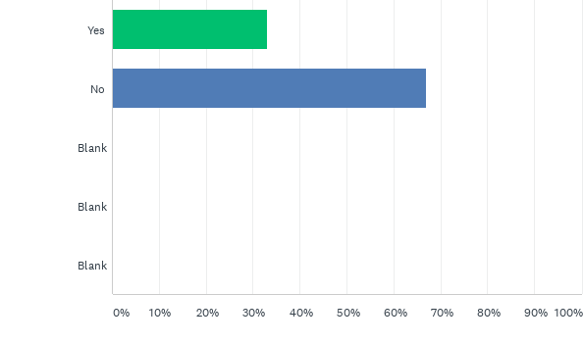
Q9: Do you have any hotels that you expect to hand the keys back to the lender or enter into a forced sale situation?
Answered: 103 Skipped: 0

Slide 20
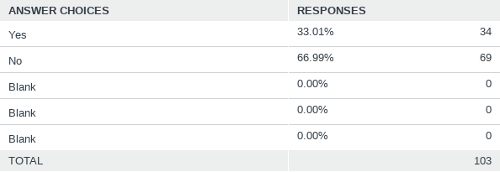
Q9: Do you have any hotels that you expect to hand the keys back to the lender or enter into a forced sale situation?
Answered: 103 Skipped: 0

Slide 21
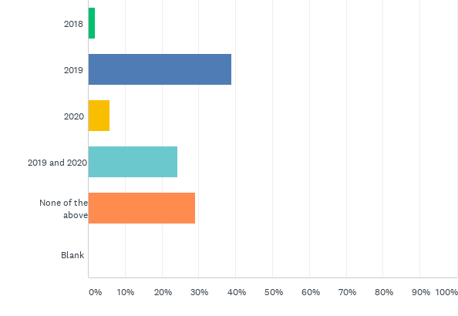
Q11: In providing guidance to your operators for 2021 what year are you using for guidance?
Answered: 103 Skipped: 0

Slide 22
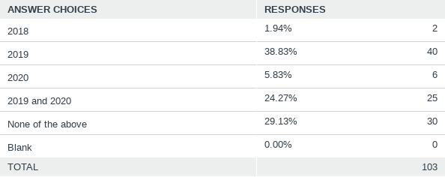
Q11: In providing guidance to your operators for 2021 what year are you using for guidance?
Answered: 103 Skipped: 0

Slide 23
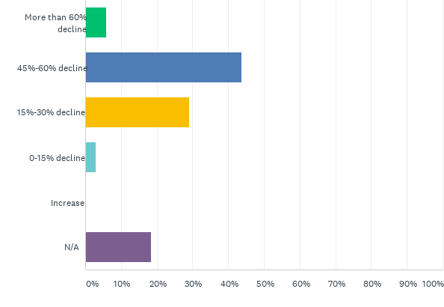
Q12: For your full-service hotels what budgeting direction are you providing for 2021 in terms of RevPAR versus 2019? (On average}
Answered: 103 Skipped: 0

Slide 24
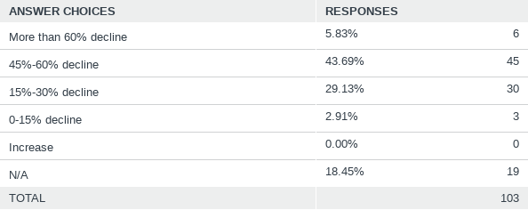
Q12: For your full-service hotels what budgeting direction are you providing for 2021 in terms of RevPAR versus 2019? (On average}
Answered: 103 Skipped: 0

Slide 25
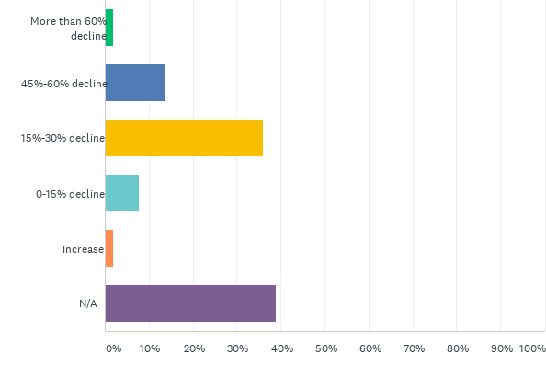
Q13: For your select and limited-service hotels what budgeting direction are you providing for 2021 in terms of RevPAR versus 2019? (On average}
Answered: 103 Skipped: 0

Slide 26
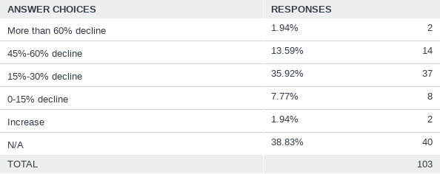
Q13: For your select and limited-service hotels what budgeting direction are you providing for 2021 in terms of RevPAR versus 2019? (On average}
Answered: 103 Skipped: 0

Slide 27
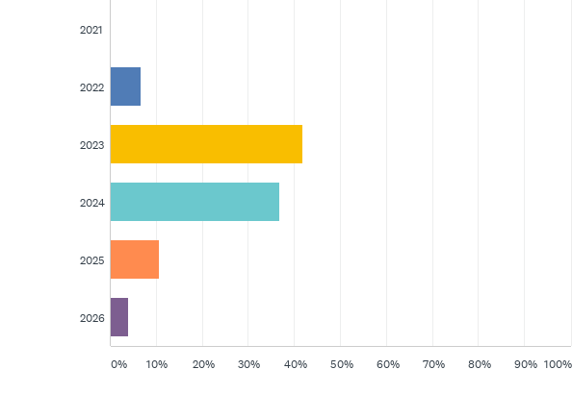
Q14: When do you think RevPAR will return to 2019 levels for the US as a whole?
Answered: 103 Skipped: 0

Slide 28
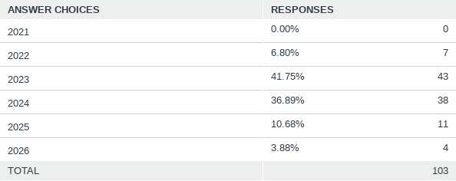
Q14: When do you think RevPAR will return to 2019 levels for the US as a whole?
Answered: 103 Skipped: 0

Slide 29
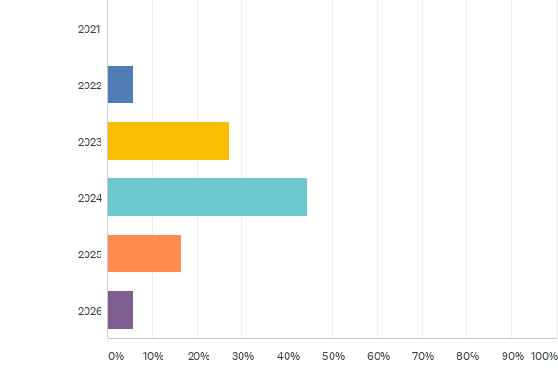
Q15: When do you think RevPAR will return to 2019 levels in the top 25 markets?
Answered: 103 Skipped: 0

Slide 30
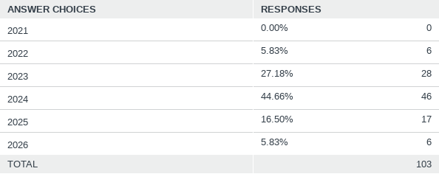
Q15: When do you think RevPAR will return to 2019 levels in the top 25 markets?
Answered: 103 Skipped: 0

Slide 31
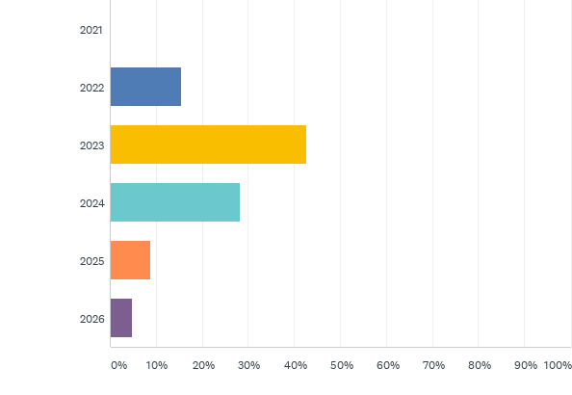
Q16: When do you think RevPAR will return to 2019 levels for the US outside of the top 25 markets?
Answered: 103 Skipped: 0

Slide 32
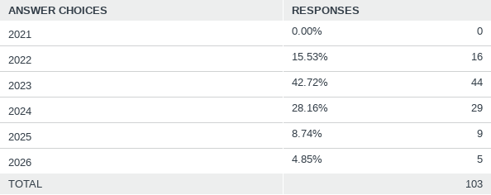
Q16: When do you think RevPAR will return to 2019 levels for the US outside of the top 25 markets?
Answered: 103 Skipped: 0

Slide 33
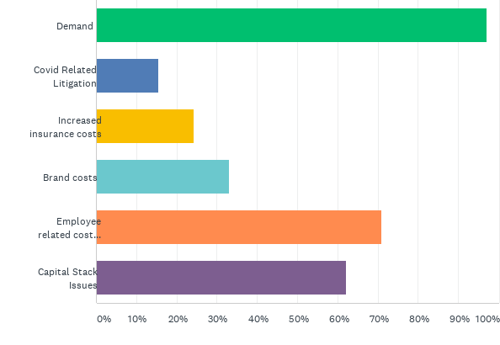
Q17: Of the following, what factors are you most concerned about right now? Please select 3
Answered: 103 Skipped: 0

Slide 34
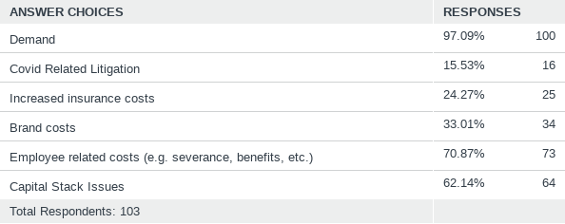
Q17: Of the following, what factors are you most concerned about right now? Please select 3
Answered: 103 Skipped: 0

